Slide 1

Intro to Web Languages
ITSC 3155

Slide 2
HTML
Hypertext Markup Language
Most basic building block of a website
Provides the structure, layout, and content of a page through tags
Links to additional HTML pages within the same site
Pulls in additional resources from the same and/or different servers

Slide 3
<html>
<head>
<title>My Page</title> <!-- Appears in the tab at the top -->
</head>
<body>
<h1>Welcome to my page!</h1>
<p>This is my website, it's not very interesting.</p>
<p>Here is some more text</p>
</body>
</html>

Slide 4
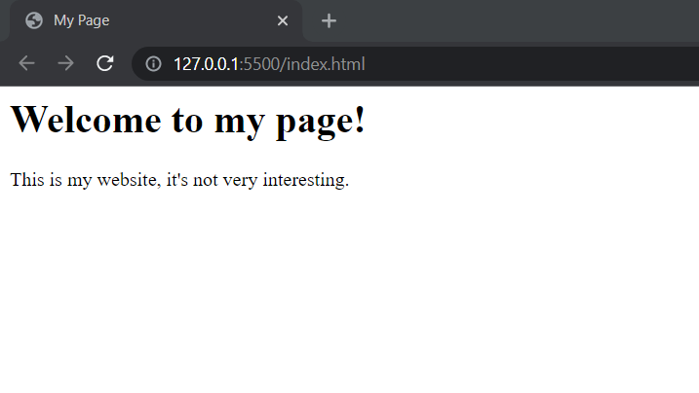

Slide 5
HTML Linking
HTML tags have different attributes which change their behavior, which are key/value pairs
The tag used to link to a new page is the anchor tag
The "a" tag has an "href" attribute which determines where the link goes
<a href="/about.html">Click Me!</a> <!-- Relative in the same server -->
<a href="https://www.google.com">Click Me!</a> <!-- Absolute to another server -->

Slide 6
Requesting additional resources
Different HTML tags request resources using a relative or absolute path
One of the most used tags of this type is the image tag, which requests an image from the same or a different server
The "img" tag includes a "src" attribute to specify the location of the image and is self closing
<img src="/woodward-hall.png" /> <!-- Relative image link -->
<img src="https://mapio.net/images-p/73548455.jpg" /> <!-- Absolute link -->

Slide 7
How to learn more html tags
If you haven't figured it out yet…
Google
But also: https://www.w3schools.com/tags/ref_byfunc.asp

Slide 8
CSS
Cascading Style Sheets
Used to provide styling to the base HTML page
Can be inline in individual tags, embedded an HTML page, or in a separate file and linked
Use selectors to target specific elements on the page for your styles
Tag selector to target all HTML tags of that type
Class selector to target every element with the same class attribute, indicated by a .
ID selector to target a single element with the same ID, indicated by a #
You can also mix different selectors together and there are more advanced ones you can look up

Slide 9
<html>
<head>
<title>My Page</title>
</head>
<body>
<h1 id="main-header">Welcome to my page!</h1>
<p class="content-paragraph">This is my website, it's not very interesting.</p>
<p class="content-paragraph">Here is some more text</p>
</body>
</html>

Slide 10
body {
background-color: lightblue;
}
#main-header {
font-size: 40px;
}
.content-paragraph {
color: red;
}

Slide 11
<html>
<head>
<title>My Page</title>
</head>
<body style="background-color: lightblue;">
<h1 id="main-header" style="font-size: 40px;">Welcome to my page!</h1>
<p class="content-paragraph" style="color: red;">This is my website, it's not very interesting.</p>
<p class="content-paragraph" style="color: red;">Here is some more text</p>
</body>
</html>

Slide 12
<head>
<style>
body {
background-color: lightblue;
}
#main-header {
font-size: 40px;
}
.content-paragraph {
color: red;
}
</style>
</head>

Slide 13
<html>
<head>
<title>My Page</title>
<link rel="stylesheet" href="/style.css" />
</head>
<body>
<h1 id="main-header">Welcome to my page!</h1>
<p class="content-paragraph">This is my website, it's not very interesting.</p>
<p class="content-paragraph">Here is some more text</p>
</body>
</html>

Slide 14
How to learn more css properties
I shouldn't have to say it…
Google
But also: https://www.w3schools.com/cssref/

Slide 15
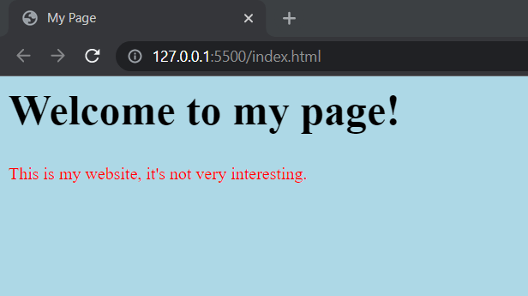

Slide 16
JavaScript
Adds interactivity and logic to a web page
Dynamic and interpreted, like Python, but has a C-like syntax like C and Java
Event driven, usually based on user events, such as when someone clicks a button
In the modern web, web apps are fully powered by JavaScript, usually in Single Page Application frameworks such as Angular, React, and Vue (but more on that later)
I could teach multiple classes on JavaScript, but in this course, we will only look at it and understand its function, you won't have to write it unless you want to

Slide 17
<script>
var title = document.querySelector('#main-header');
title.addEventListener('click', function () {
alert('You clicked the title');
});
</script>

Slide 18
